Slide 1


Panasonic System Networks Vietnam
STUDY NEW METHOD
Hanoi Dec 2018

Slide 2
CONTENT
1.SignalR
2.Web socket
3.Reactive

Slide 3
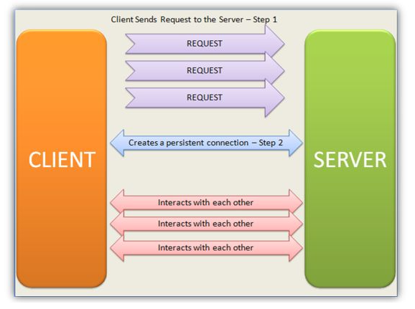
1. SignalR
Concepts
SignalR is a library for ASP.NET developers that simplifies the process of adding real-time web functionality to applications.
It offers a simple and clean API that allows you to create real-time web applications where the server needs to continuously push data to clients.
"Real-Time" in terms of a web application would mean "An immediate response sent by the Server on the Client's request".
SignalR provides a simple API for creating server-to-client remote procedure calls (RPC).
Signalr supports “server push” functionality, where the code is on the server side.
SignalR takes advantage of WebSocket, an HTML5 API that enables bi-directional communication between the browser and server.
SignalR Interactions
The Client sends requests to the Server. The Server, using SignalR, checks if the Client supports any of the following data transportation techniques: Web Sockets, Forever Frames, Server-Sent Events, Long Polling (*)
(*) These concepts are used to create a persistent connection with the server and allow the client to interact with a Server.

Slide 4


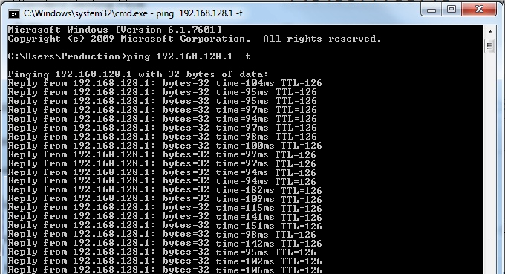


2.Observation & Setup Target
Use PING command
on Window
How to measure network slowness?

Slide 5


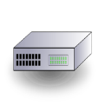




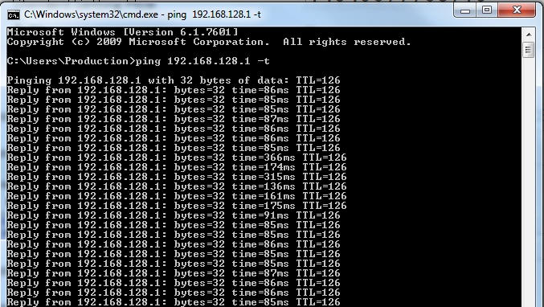
2.Observation & Setup Target
Current situation
Access Point
Wifi
IIIIIIIIII
Server
FOSS
Switch
Core Switch
Firewall
Core Switch
IIIIIIIIIIIIII
LAN
LAN
LAN
LAN
WEIGHT
SYSTEM
LAN
Ping
121ms
Reduce Ping Response time to: <10ms

Slide 6





3.Make Schedule
Action Plan
 |  | What |  | When |  |  |  |  |  |  |  |  |  | How
 |  |  |  | Apr | May | Jun | Jul | Aug | Sep | Oct | Nov | Dec | PIC | Tools
 | 1 | Select Theme | Factory |  |  |  |  |  |  |  |  |  | All
 | 2 | Establishing Target |  |  |  |  |  |  |  |  |  |  | All
 | 3 | Action Plan |  |  |  |  |  |  |  |  |  |  | All
 | 4 | Analyses Cause |  |  |  |  |  |  |  |  |  |  | All
 | 5 | Countermeasure |  |  |  |  |  |  |  |  |  |  | All
 | 6 | Confirming Effect |  |  |  |  |  |  |  |  |  |  | All
 | 7 | Standardization |  |  |  |  |  |  |  |  |  |  | All
 | 8 | Review & Orientation |  |  |  |  |  |  |  |  |  |  | All
Where
Who
No
Content
Location
Plan
Actual

Slide 7



4.Analysis Main Cause
METHOD
MAN
Program
4
Software
Wifi
Network Design
Wrong Operation
3
Database
Network Setting
Configuration of
switch & Router
Reduce
Network
Response Time
Performance
Card
Reader
Switch, Router
CPU, RAM
1
Server
Barcode NG
2
Network Card
Performance
RAM
Access Point
PC
CPU
Network Card
MACHINE
MATERIAL

Slide 8

4.Analysis Main Cause
 | Analyze |  | Effect | Lead time | Archive | Rank | Action | Remark
Material | No | Barcode NG |  |  |  | No
Man | No | Wrong Operation |  |  |  | No
Machine | Card Reader |  |  |  |  | No
 | PC | Network Card |  |  |  | No
 |  | CPU |  |  |  | No
 |  | RAM |  |  |  | No
 | Server | Network Card |  |  |  | No
 |  | CPU, RAM | 5 | 5 | 25 | A | Increase RAM, CPU | Action 1
 | Access Point | Performance | 5 | 4 | 20 | A | Add more Access point | Action 2
 | Switch, Router | Performance |  |  | 0 | No
Method | Software | Program |  |  | 0 | No
 |  | Database | 4 | 4 | 16 | B | Archive Database | Action 3
 | Network Setting | Wifi Matter | 4 | 4 | 16 | B | Change to LAN cable | Action 4
 |  | Configuration of Router | 3 | 3 | 9 | C | Refine Configuration | Action 5
 |  | Network Design | 3 | 2 | 6 | C | Move Database server from Office to Production size | Action 6
1
2
3
4
5
6

Slide 9
4.Analysis Main Cause
2
4
Access Point
Wifi
5
1
3
6
IIIIIIIIII
Core Switch
Firewall
Core Switch
Server
FOSS
Switch
IIIIIIIIIIIIII
WEIGHT
LAN
LAN
LAN
LAN
LAN
WEIGHT
CAUSE

Slide 10
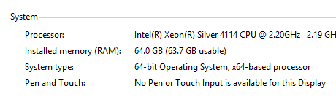
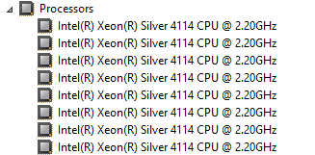
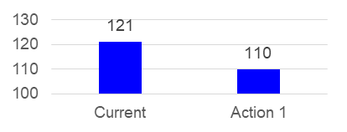
5.Implement Solution (Action1)
Increase Ram & CPU for Server
Negotiate Section for downtime & test
Access Point
Wifi
1
IIIIIIIIII
Core Switch
Firewall
Core Switch
Server
FOSS
Switch
IIIIIIIIIIIIII
LAN
LAN
LAN
LAN
WEIGHT
SYSTEM
LAN
110ms
Response reduce 9%

Slide 11
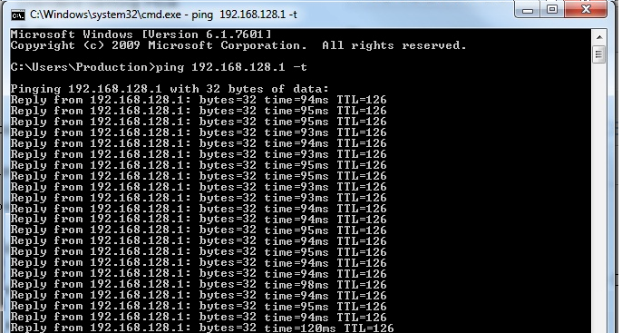
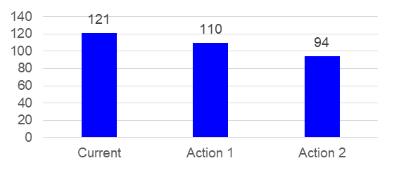
5.Implement Solution (Action2)
Add more Access point
Access Point
Wifi
2
IIIIII
FOSS
Switch
Core Switch
Firewall
Core Switch
Server
IIIIIIIIIIIIII
LAN
LAN
LAN
LAN
WEIGHT
SYSTEM
LAN
94ms
Response reduce 22%

Slide 12
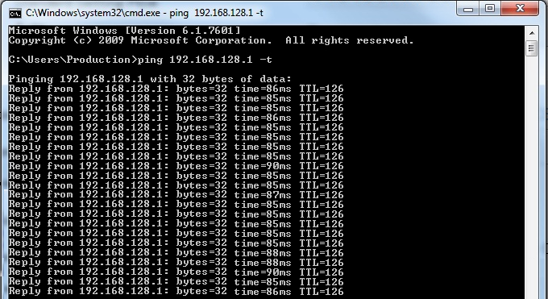
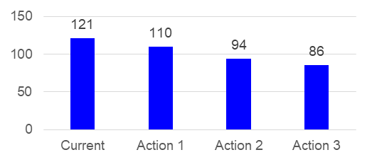
5.Implement Solution (Action3)
Archive Database (reduce Database size)
Negotiate Section for downtime & test
Recent 3months
Over 3 months
Over 3 months
Recent 3months
Archive to other location
86ms
Response reduce 29%

Slide 13

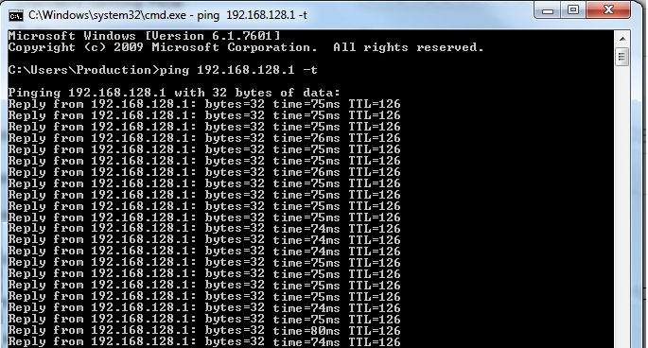
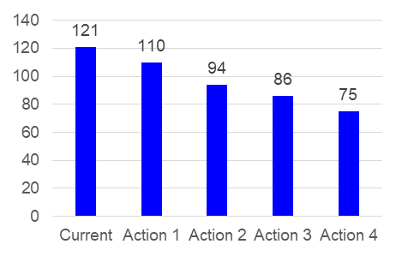

5.Implement Solution (Action4)
1. Change wifi to LAN cable
1. Negotiate Section for downtime
2. Test schedule for deploy
Access Point
Wifi
2
IIIIII
FOSS
Switch
Core Switch
Firewall
Core Switch
Server
IIIIIIIIIIIIII
LAN
LAN
LAN
LAN
WEIGHT
SYSTEM
LAN
75ms
Response reduce 38%
Can not Apply
for PDA
Still need to improve

Slide 14
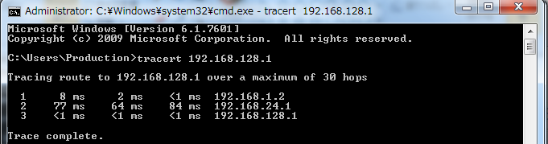
5.Implement Solution (Action5)
Try another METHOD?
Use TRACERT command
on Window
Separate result by segment
1
3
2

Slide 15

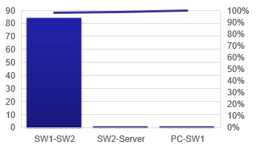

5.Implement Solution (Action5)
Tracert Result for Current Network
Access Point
Wifi
5
IIIIII
Firewall
FOSS
Switch
Core Switch1
Core Switch2
Server
IIIIIIIIIIIIII
LAN
LAN
LAN
LAN
1ms
84ms
1ms
WEIGHT
SYSTEM
LAN
Pareto
Need to Improve Firewall

Slide 16

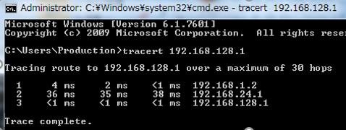
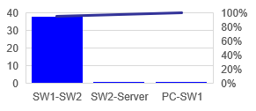
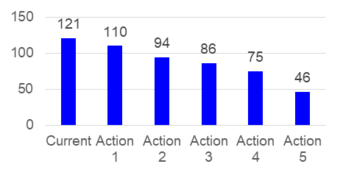
5.Implement Solution (Action5)
1. Refine configuration of Fire wall & Delete unnecessary config.
→ Negotiate Section for downtime & test
Access Point
Wifi
IIIIII
5
FOSS
Switch
Core Switch1
Firewall
Core Switch2
Server
IIIIIIIIIIIIII
LAN
LAN
LAN
LAN
1ms
38ms
1ms
WEIGHT
SYSTEM
46ms
Response reduce 62 %

Slide 17

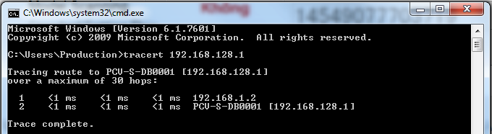
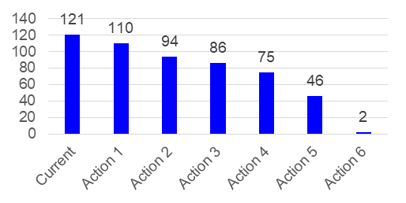
5.Implement Solution (Action6)
Change Database location from Office to Production ( Separate Host)
Server
Access Point
Wifi
6
IIIIII
1ms
FOSS
Switch
Firewall
Core Switch2
Server
IIIIIIIIIIIIII
Core Switch1
LAN
LAN
WEIGHT
SYSTEM
1ms
2ms
Response reduce 98 %
Notes:
Can not Improve Firewall more, We need to re-design network, Minimize device between Client & server

Slide 18

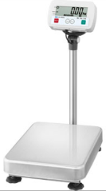



6.Confirm Effect
QUICK
FOSS System
Weight check System
PDA
Database server
Production
System affect | Times/month | Related person | Lost time (h/year) | Cost($)
Weight check line | 0 | 1 | 0 | 0
FOSS system | 0 | 100 | 0 | 0
Total | 0 | 101 | 0 | 0
Archive Target

Slide 19
7.Standardization & Control
Access Point
Wifi
IIIIIIIIII
Core Switch
Firewall
Core Switch
Server
FOSS
Switch
IIIIIIIIIIIIII
LAN
LAN
LAN
LAN
WEIGHT
SYSTEM
LAN
Calculate Deeply affect of Firewall
when place between Client & Database Server
Set Quarterly Archive Database

Slide 20
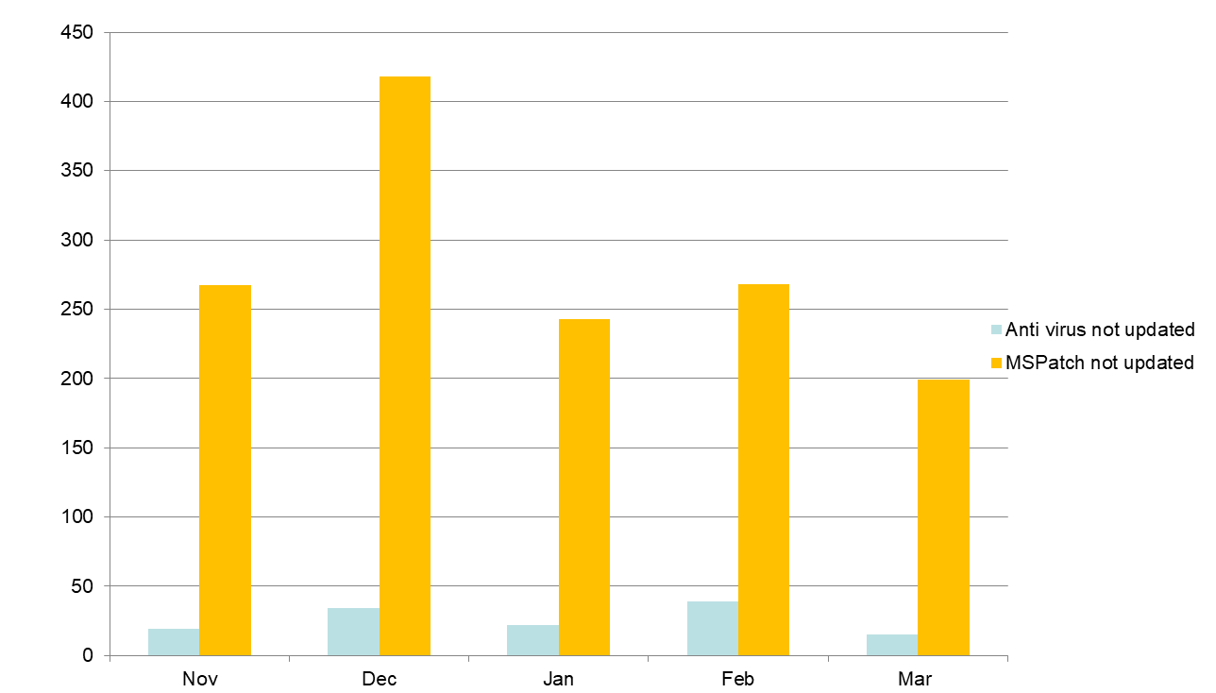
8.New Action
Reduce Trouble happen to PCs monthly
(PC)
GPCL monthly Report, Number of PCs not update

Slide 21
Thank you for your time !

